Slide 1
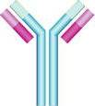
Immunology Biol 465 Minot State University Spring 2020
MWF 9-9:50 am
Lab Tuesdays 9am-noon

Slide 2
Lecture 3 January 22, 2020
Great job in lab---attention to detail and enthusiasm. Your blood smears looked professional!
Be sure to revisit the lab protocol and background and expectations for your lab journal. Different students will have different strengths/familiarity with aspects of the lab. Don’t skim!

Slide 3
Where were we?
Name a cell and a response which is part of innate immunity.
In what way is adaptive immunity “better” than innate?
What does the following figure show us?
How do immune system cells “see” pathogens
What’s an epitope?
What’s humoral immunity? What is cell-mediated immunity?

Slide 4
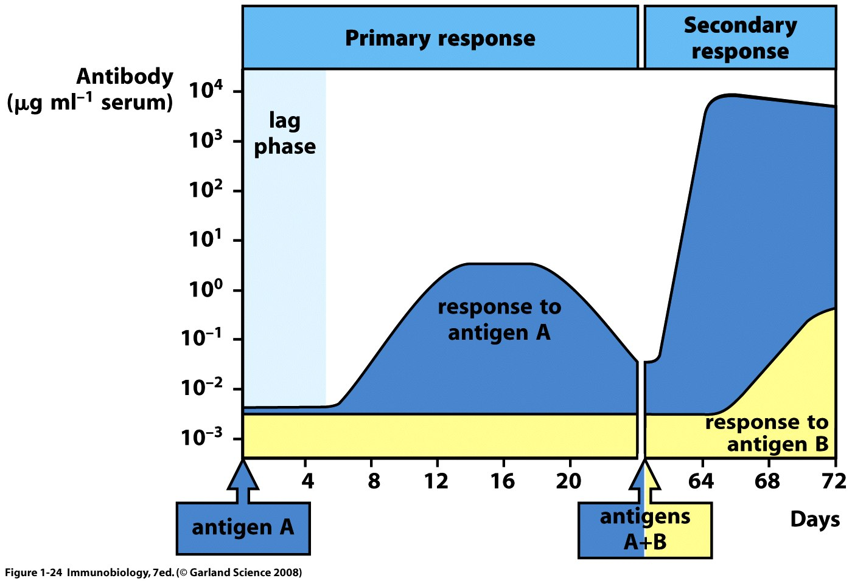
Figure 1-23
Antibodies are produced by B-lymphocytes

Slide 5
Normal immune responses are a delicate balance of recognizing a pathogen and responding appropriately and at the same time, ignoring tissues, cells, molecules that belong to the host.
Called self tolerance

Slide 6
Inappropriate immune responses come in 2 basic forms.
1. Autoimmunity---failure to establish self tolerance. An individual mounts an immune response against body tissue.
Lupus
Multiple Sclerosis
Rheumatoid athritis
Graves disease
Diabetes

Slide 7
2. Immune failure
Immunodeficiency
Immunosuppression
Normal in babies and elderly
Can be caused by the pathogen itself
Can be caused by medication
Can be inherited genetic defect

Slide 8
Extreme example
Severe Combined Immune Deficiency
SCID
Individual makes no B or T cells. No adaptive immune response at all. Very serious.
“Bubble Boy” disease.

Slide 9
Final thought in our introduction.
The study of immunology has allowed development of amazingly specific technologies based on the specificity of antigen and antigen receptors.
e.g. Antibodies can be used in medical diagnostics, disease treatment, and monitoring…You used some commercially made antibodies for blood typing….

Slide 10
Many examples
If you purify antibodies that detect a pathogen or molecule of interest say…the HIV virus or its proteins, you can use those antibodies to detect HIV in a person’s blood.
Not every test is as easy as looking for agglutination. But the antibody can be altered in a way to make it visible. (like adding a fluorescent molecule, or a molecule that changes to make color)

Slide 11
Immunofluorescence

Slide 12
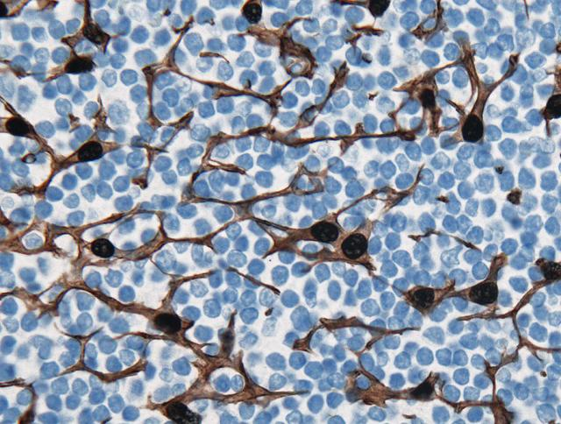
Immunohistochemistry

Slide 13
Antibodies can even block normal interactions of cell receptors and their ligands (things that bind receptors).
Some disease treatments include antibodies to block receptors.
Breast cells can be blocked from binding estrogen which can make them divide abnormally---breast cancer. Basis of a drug called Herceptin

Slide 14
Immune checkpoint blockade therapy uses antibodies to block the normal receptors that suppress immune T-cells from killing cancer cells. The block—by binding antibodies releases the brakes on the immune system.
Anti-PD-1 therapy is treatment with antibodies that bind to PD-1.

Slide 15
Both of the previous examples are sometimes referred to as “living or biologic” drugs. They are made inside cells or using cellular components.
Many are antibodies-—Humira---is another example of antibody-treatment. Humira blocks activities of immune system cells associated with autoimmune diseases like Rheumatoid arthritis.

Slide 16
Often the pharmaceutical name for the drug is harder to pronounce!
Humira = Adalimumab
mab in a drug name usually indicates monoclonal antibody.
Herceptin= Trastuzumab

Slide 17
Action of Herceptin/Trastuzumab

Slide 18
Immunology’s beginnings...
When did immunology start? Who first observed an immune response or immunity?
---Credit given to Edward Jenner (late 18th century). Recognized that women who milked cows for a living contracted a disease called cowpox (skin lesions/pox), but seemed protected against small pox.

Slide 19
Jenner hypothesized that exposure to a substance in cowpox sores protected against exposure to small pox.
He designed the first immunization by passing a thread through the cowpox sore and then inserting the thread in another’s skin.
The term vaccine comes from this work since the cowpox/small pox virus is called Vaccinia.

Slide 20
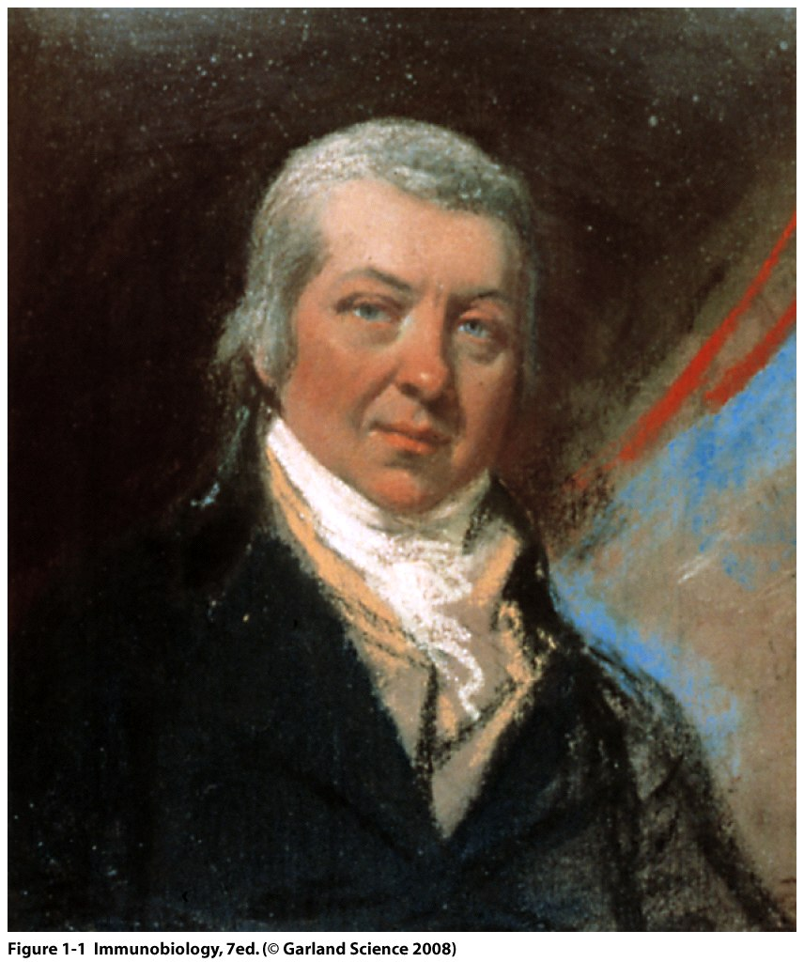
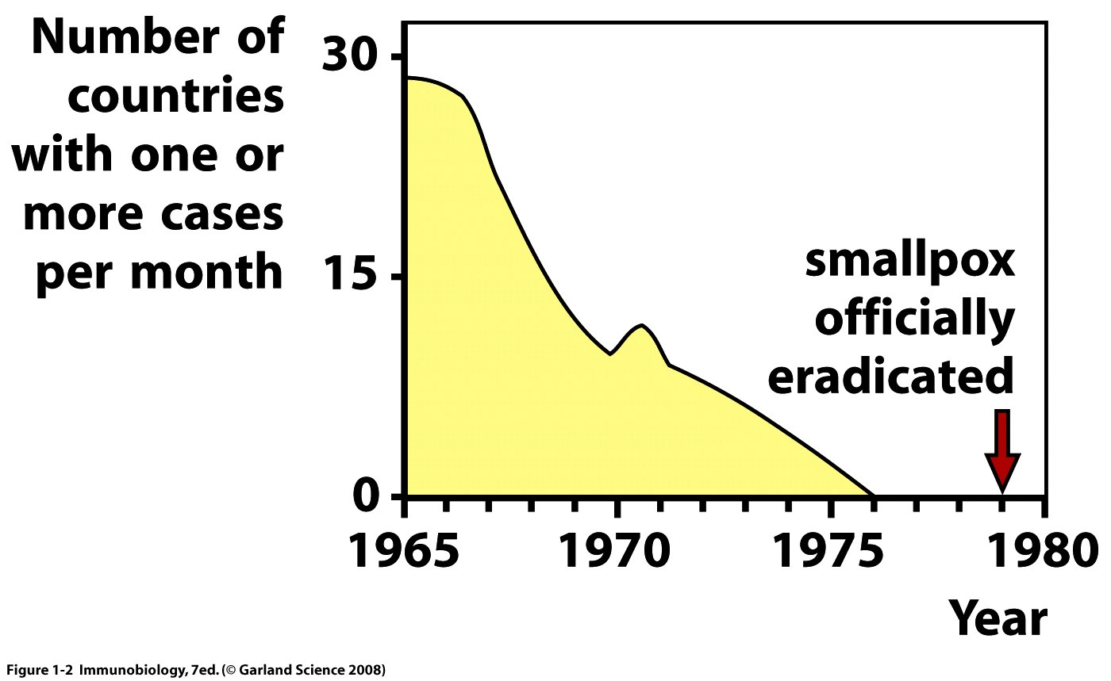

Slide 21
About a century after Jenner, Louis Pasteur, who contributed greatly to the field of microbiology and to a germ theory for disease, developed several vaccines:
Cholera (in chickens)
Rabies (in humans)

Slide 22
About the same time as Pasteur…
2 scientists determined that some agent of protection against infectious diseases was found in the serum of “immune” individuals.
Emil von Behring and Shibasaburo Kitasato had discovered antibodies…a key player in adaptive immunity.

Slide 23
The transfer of serum-containing antibodies from one animal to another may confer short-lived immunity. It continues to be used in some medical situations today.
One example of “passive immunity”

Slide 24
Ellie Metchnikoff is often mentioned as the first to observe cells engaged in phagocytosis.
Said to have noticed cells of sea urchins engulfing bacteria. Now know these were related to macrophages and the sea urchins were initiating an innate immune response.

Slide 25
Charles Janeway…late author of your textbook. Pioneer in study of innate immunity. Identified receptors on macrophages called Toll-like receptors.
Extremely important discovery!!
Many other contributors…!

Slide 26
Let’s get started…
Components of the immune system.
Cells
The leukocytes used in innate and adaptive immunity originate in the bone marrow. They come from a plurpotent, self-renewing stem cell. The hematopoietic stem cell can also differentiate along 2 main pathways.
Lymphoid pathway/lineage
Myeloid pathway/lineage

Slide 27
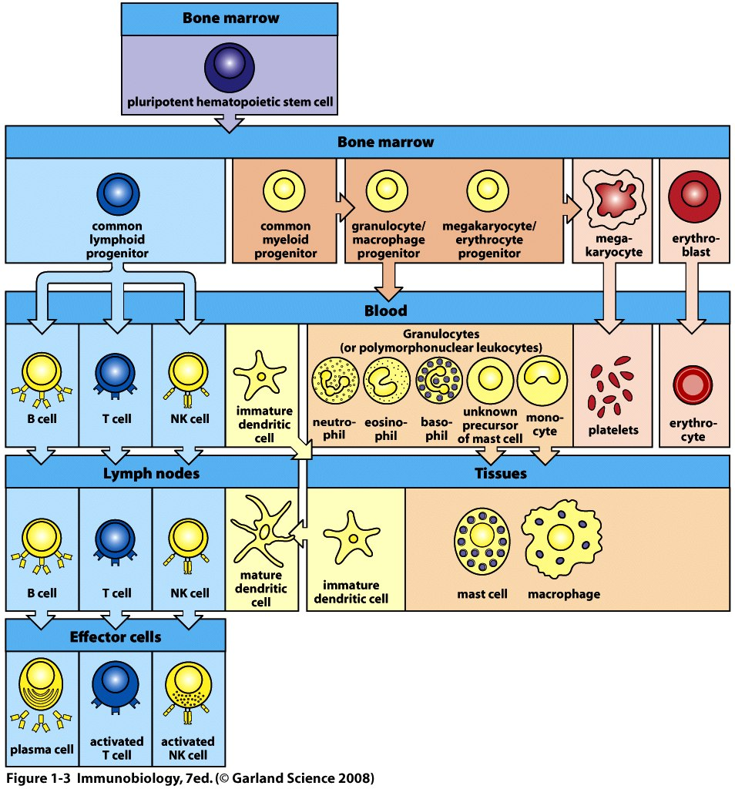

Slide 28
This figure shows the development of the cells, their location during development, and their final location as mature, working cells—which we will call effector cells.
Become familiar with the figure. Redraw it!

Slide 29
Myeloid cells
1. Granulocytes—Have odd shaped, multi-lobed nuclei and densely staining granules in cytoplasm. Also called Polymorphonuclear leukocytes-PMNs)
3 types
Neutrophils—phagocytes—bacteria fighters
Eosinophils---recognize parasites which are bound to antibodies—kill them.
Basophils—allergic responses, parasites
Mast cells also contain granules but have regular nuclei—release histamine in allergic reaction

Slide 30
Myeloid cells
Monocytes—circulate in the blood and move into tissues to mature into macrophages.
Many roles in innate immunity
Phagocytes—directly engulf pathogens
Trigger inflammation
Activate other cells
Interact with lymphocytes to initiate adaptive responses

Slide 31
Myeloid cells
Dendritic cells
Arguably the most important type of phagocyte in the immune system.
Primary role is to ingest fluid in tissues to obtain a sample of the contents.
Continually present small pieces of proteins (peptides) to T-cells. These antigens may activate the T-cells and initiate an adaptive immune response.

Slide 32
Dendritic cells link innate and adaptive immunity. (Figure 1-5)
Dendritic cells are considered Antigen Presenting Cells (APCs). Since this is their sole purpose, they are sometimes referred to as professional APCs.

Slide 33
Lymphoid cells
B-lymphocytes
T-lymphoctyes
Natural Killer cells
All derived from a common progenitor cell
B and T-cells----adaptive immunity
NK cells---innate immunity.

Slide 34
NK cells
Kill some tumor cells
Kill some virus-infected cells, especially herpes virus.
**Do not express the highly specific antigen receptors like B and T cells

Slide 35
B and T cells
Circulate in blood AND congregate in lymphoid tissues.
B-cells mature in bone marrow
T-cells originate in the bone marrow, but mature in an organ called Thymus
Both express highly variable and specific antigen receptors

Slide 36
Lymphoctyes
B-cells express a B-cell antigen receptor (BCR), which is a membrane anchored antibody molecule. An activated B-cell will eventually secrete the same form of the antibody.
T-cells express a T-cell receptor (TCR), which is membrane anchored and never secreted.

Slide 37
T-cells
3 types
Helper T-cells
Cytotoxic T-cells
Regulatory T-cells (We don’t spend much time on these)

Slide 38
Development of lymphocytes
Both B- and T-cells begin in the bone marrow.
Terms—in chronological order…
B-cells---immature, mature, naïve, activated (effector), plasma cells, memory cells.
T-cells---immature, mature, naïve, activated (effector), memory

Slide 39
Lymphoid tissues/organs
Body has different locations of organized tissues containing lymphocytes.
2 main distinctions
1. Central lymphoid organs---Where lymphocytes form and mature.
2. Peripheral lymphoid organs--- Where mature, naïve lymphocytes hang out and where adaptive immune responses are initiated.

Slide 40
Examples…
Central---bone marrow and thymus
Peripheral—lymph nodes, spleen, and tissue-associated lyphoid tissues.
Gut
Nasal/respiratory tract
Urogenital tract

Slide 41
